Slide 1
College Scorecard: Student Earnings Analysis
With the rising costs of higher education, prospective students and parents are faced with difficult choices about which college to attend.
While there are many non-financial benefits to attending college, my presentation will focus on the potential for higher earnings after college.
My presentation will analyze student earnings a decade after enrollment by institution, region, selectivity, and other factors, to help guide students looking to maximize their earnings after college.

Slide 2
Executive Summary
Students looking to maximize their future earnings should consider schools in the Far West, Mid East, and New England.
Engineering schools ($69.5K) and Universities with very high research activities ($57.2K) offer the highest mean earnings.
Factors that are positively correlated with mean earnings are SAT equivalent scores and completion and retention rates. The percentage of students receiving Pell Grants is negatively correlated with mean earnings.
There is a positive correlation between median earnings and median family income of students attending the college.
Top 5 Mean Earnings after 10 Years
Top 5 Best Deals
(Lowest Median Debt/Earnings Ratio)
California Institute of Technology: $104K
1
2
Massachusetts Institute of Technology: $117K
3
4
Princeton University: $105K
5
Harvard University: $120K
University of Pennsylvania: $107K
University of Western States: 3.8%
Capella University: 5.4%
California Institute of Technology: 6%
U.S. Merchant Marine Academy: 6.2%
1
2
3
4
5
CUNY Medgar Evers College: 7.3%
*Data from U.S. Department of Education College Scorecard (2009-2010 AY)

Slide 3
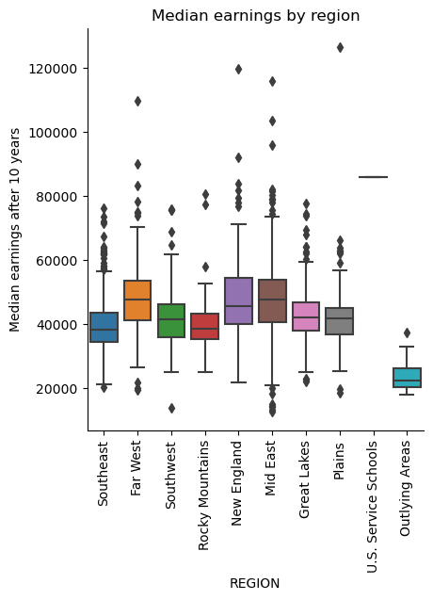
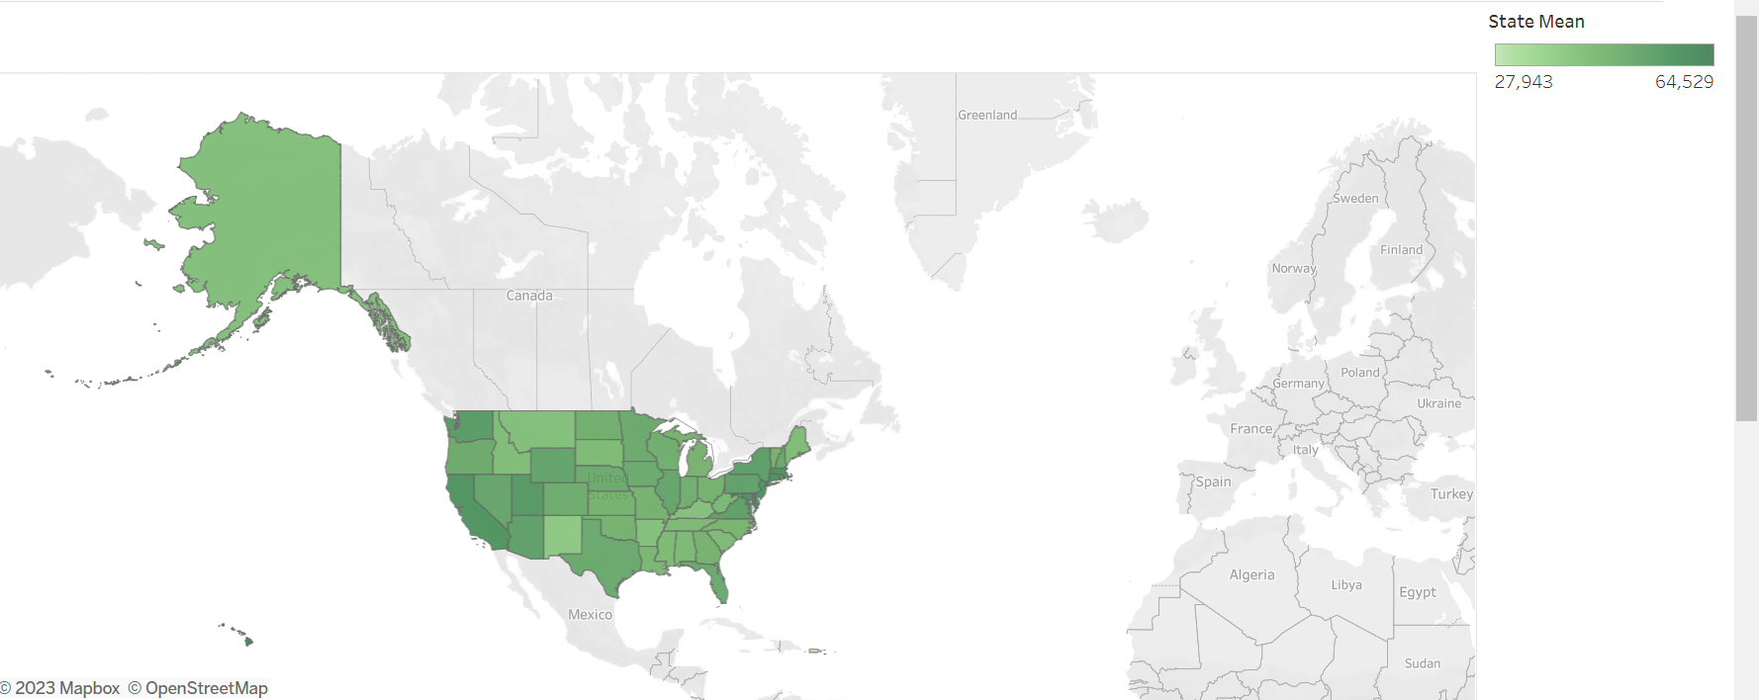
10-year student earnings by Region
Students attending institutions in the Far West, Mid East, and New England tend to have higher earnings after 10 years while those in Outlying Areas have the lowest earnings.
In the Continental U.S., students attending schools in CT ($58.3K) and MA ($58.2) have the highest average earnings while those in NM ($38.6K) and KY ($41.4K) have the lowest.

Slide 4
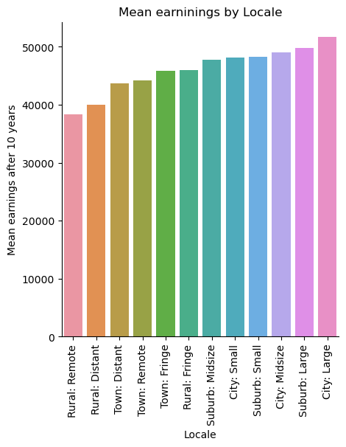
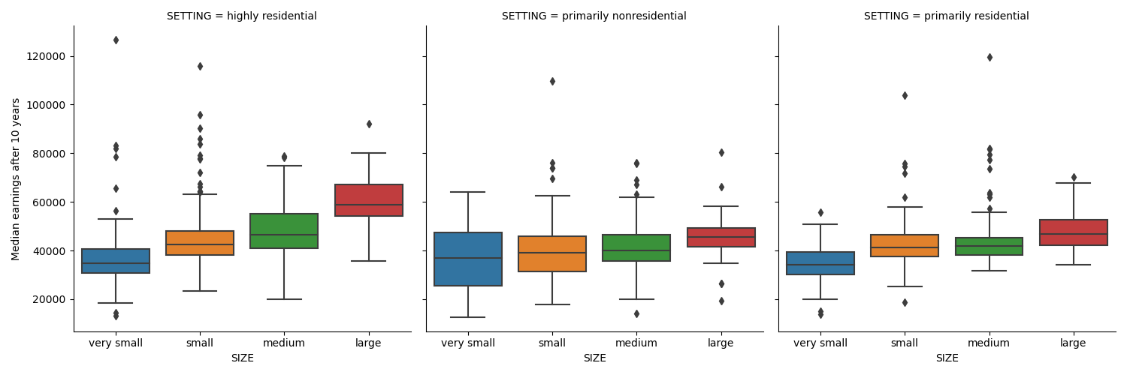
Institution Size, Setting, and Locale
*Size and setting based on Carnegie Classifications.
For each residential setting, larger schools tend to have higher median earnings with this trend most pronounced for highly residential colleges.
Institutions based in large cities have the highest mean earnings ($51.7K) while those in remote rural areas have the lowest ($38.4K).

Slide 5
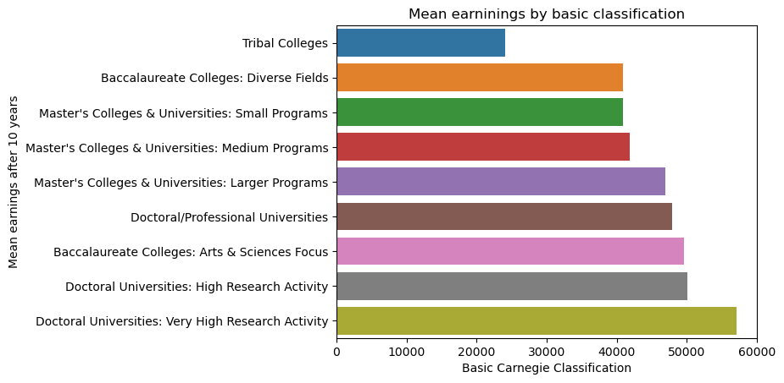
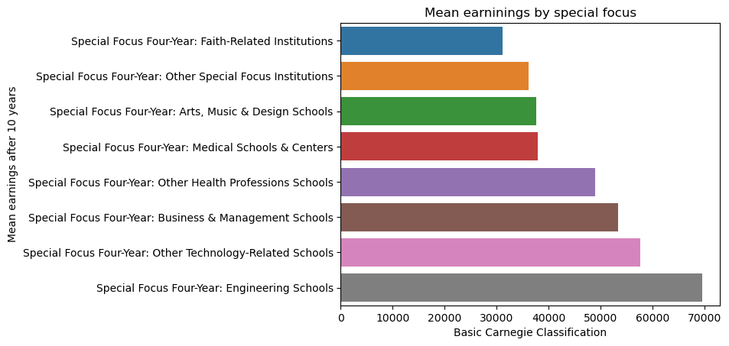
Institution Type
*Based on Carnegie Classifications.
Tribal colleges have the lowest mean earnings($24.1K) while Doctoral universities with very high research activity have the highest ($57.2K).
Among schools with a special focus, students attending Engineering schools have the highest average earnings ($69.5K) and those at Faith-related institutions have the lowest ($31.1K).

Slide 6
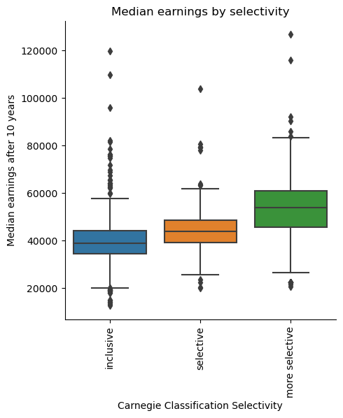
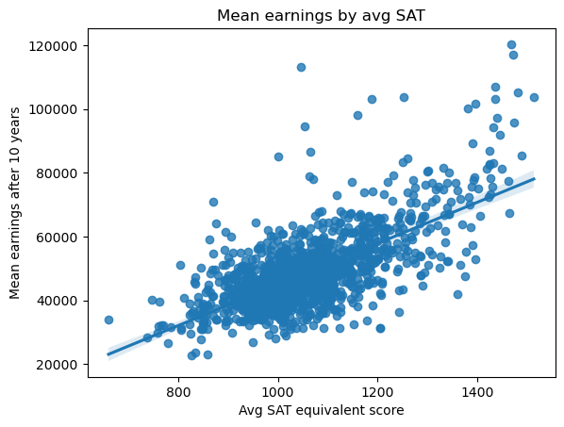
Selectivity
r = .455
Undergraduate institutions that are more selective have higher median earnings.
Approximately 46% of the variability in mean earnings can be explained by the average SAT equivalent scores of students accepted to the school.

Slide 7
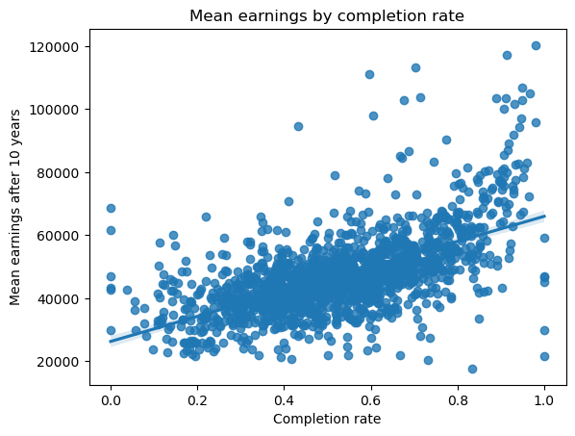
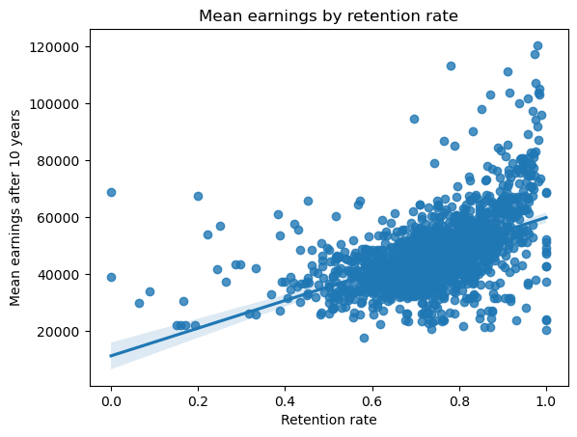
Completion and Retention Rates
r = .363
r = .257
Mean earnings are also positively correlated with completion and retention rates.
As a larger percentage of students remain at the institution and complete their studies within 150% of the program duration, the higher students' average earnings after 10 years.

Slide 8
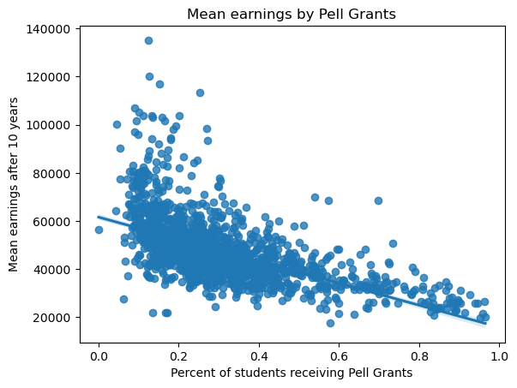
Pell Grants
r = .339
*Federal Pell Grants are awarded to students on the basis of exceptional financial need.
There is a negative relationship between the percentage of students receiving Pell Grants* and mean earnings.
The more Pell Grant recipients attending an institution, the lower the mean earnings.

Slide 9
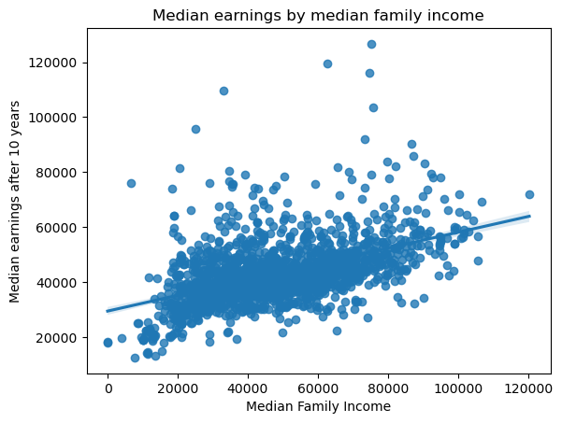
Family Income
r = .249
Finally, median student earnings after 10 years are weakly related to median family income at the institution.
Those attending schools where students come from higher-earning households tend to have higher earnings themselves.

Slide 10

Conclusion
Regional trends: Schools in the Far West, Mid East, New England have the highest earnings; Outlying Areas have the lowest.
Financial Factors: Mean earnings are negatively correlated with the percentage of Pell Grant recipients. Students attending schools with higher median family household income tend to have higher median earnings.
Institutional Factors: There are positive correlations between mean earnings and SAT scores and with completion/retention rates. Schools' focus, size setting, and locale also impact future earnings.

Slide 11
Limitations
There are many outliers in the data making linear regression less reliable.
My analysis does not consider other aspects of institution selectivity such as ACT scores, grades, or student portfolios.
This data is from 2009-2010 to capture earnings after 10 years. The economy, job market, and academic environment have changed and will continue to change in the future.

Slide 12
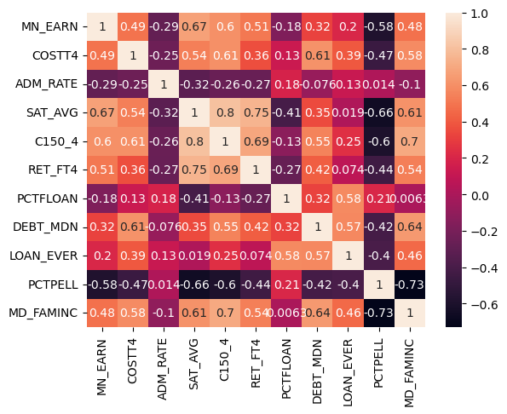
Other Factors
The analysis also evaluated cost of attendance, admission rate, percent of students receiving loans, and median debt.
These factors did not have a significant correlation to mean student earnings.

